Slide 1
Instructions for use
This resource aligns to the learning in Stage 2 Year B Unit 35 and revisits content from earlier sample units.
Classroom teachers are encouraged to add and adapt slides as required to meet the needs of their students.
Save a copy of the file to make changes to the slide deck. Go to File > Download a Copy (this downloads a copy to the computer to edit in the PowerPoint app).
To convert the PowerPoint to Google Slides:
  Upload the file into Google Drive and open it.
  Go to File > Save as Google Slides.
  (Note – conversion may cause formatting changes in the slides.)

Slide 2

Review of Learning
Mathematics Stage 2 – Unit 35
Notes:
Reviews may include a combination of question types, requiring students to recall facts and key ideas, as well as apply their knowledge to solve problems and answer questions. To support active engagement, a mix of techniques should be employed.” (AERO, 2024).
This Review of Learning slide deck revisits key concepts from the following units:
Stage 2 Year B Unit 35
Stage 2 Year B Unit 34
Stage 2 Year B Unit 33
It also includes opportunities to review prior learning in non-number content, supporting consolidation across focus areas.
The review of learning resources include three key task types that support the development of mathematical proficiency through retrieval, spaced practice, and active participation. These practices complement the review phase (activating prior knowledge) embedded within the beginning of each lesson.
1.
Multiple-choice questions/True or false: Designed to promote active retrieval of key concepts and identify common misconceptions in number, supporting consolidation, understanding and fluency.
These questions:
support spaced and interleaved practice
help identify and address common misconceptions
support active recall and immediate feedback
support whole class participation
identify areas requiring reteach
2.
Short-response question sets: Carefully grouped questions that encourage spaced and interleaved practice across multiple focus areas, helping students revisit and apply knowledge from different points in time.
These questions:
have a combination of question types
address a range of focus areas
build automaticity and fluency
support active recall
allow for immediate feedback
identify content requiring reteach
3.
Developing number sense activities: A variety of practical, purposeful tasks that reinforce current learning and build on prior knowledge. These activities promote reasoning, problem-solving and conceptual understanding.
The review of learning resources are designed to work support teaching and learning in mathematics. For the most effective implementation, use the resources flexibly, adapting to meet student learning needs and individual classroom contexts.

Slide 3
Lessons
1
Review of learning 1
5
Review of learning 5
2
Review of learning 2
6
Review of learning 6
3
Review of learning 3
7
Review of learning 7
4
Review of learning 4
8
Review of learning 8
Notes:
Teacher notes:
Click lesson titles to go to specific lessons
Interactive features can be viewed in slide show

Slide 4
Review of learning 1

Slide 5


Multiple choice (1)
94 − = 67
A
24
B
27
C
37
D
34
Notes:
This question connects to the content in the developing number sense activity (Activity 1)
Syllabus focus area:
Additive relations B

Slide 6

Short response (1)
79 – 15 = ◻◻ – ◻◻
Communicate your reasoning.
Notes:
Short response questions provide brisk paced questions focussing on review of current and previous content to support spaced and interleaved practice.
Syllabus focus area:
Additive relations A

Slide 7
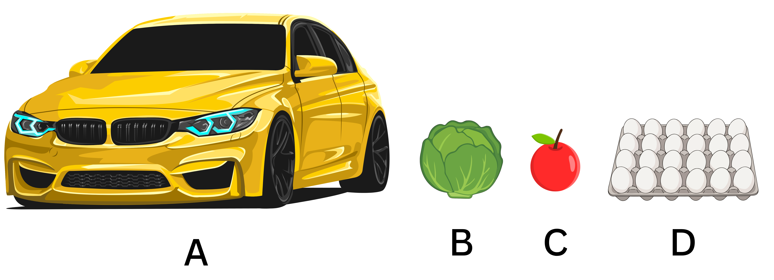
Short response (2)
Record the objects that have a mass of
about 1 kilogram.
Notes:
Short response questions provide brisk paced questions focussing on review of current and previous content to support spaced and interleaved practice.
Syllabus focus area:
Non-spatial measure A

Slide 8
Short response (3)
Record the first ten multiples of 6.
Notes:
Short response questions provide brisk paced questions focussing on review of current and previous content to support spaced and interleaved practice.
Syllabus focus area:
Multiplicative relations A

Slide 9
Short response (4)
Start at the school office.
Go east past the canteen.
Head south when you reach the long jump pit.
What area can you see when you look east?
Notes:
Short response questions provide brisk paced questions focussing on review of current and previous content to support spaced and interleaved practice.
Syllabus focus area:
Geometric measure B

Slide 10

Activity 1 – finding unknown quantities
Find the missing numbers that make both sides of a number sentence equal.
__ − 15 = 19
__ + 9 = 17
32 − __ = 19
25 + __ = 48
__ − 14 = 6
56 = __ + 27
78 − __ = 42
__ + 16 = 35
49 = 37 + __
83 = 55 + __
Notes:
This is a developing number sense activity.
Number sense refers to a deep understanding of numbers, including their magnitude, relationships, and the effects of operations on them. It supports fluency and understanding, estimation, flexible thinking, and efficient problem-solving. Number sense activities 1–4 ‘activate’ prior number knowledge and support the learning of new content in the unit. Number sense activities 5–8 ‘loop’ back and provide opportunity for spaced practice with concepts and procedures covered in previous units.
Syllabus focus area:
Additive Relations B
Finding unknown quantities
Students solve the number sentences to find the missing number and record their answers on an individual whiteboard.
Encourage students to show and explain the strategies they applied.
Discuss the strategies used to solve the problems.

Slide 11
Review of learning 2

Slide 12
True or false (1)
The missing number is 21:
54 + 17 = 98 −
True | False
Communicate your reasoning.
Notes:
The question on this slide connects to the content being explored in the developing number sense activity (Activity 2)
Syllabus focus area:
Additive relations B

Slide 13
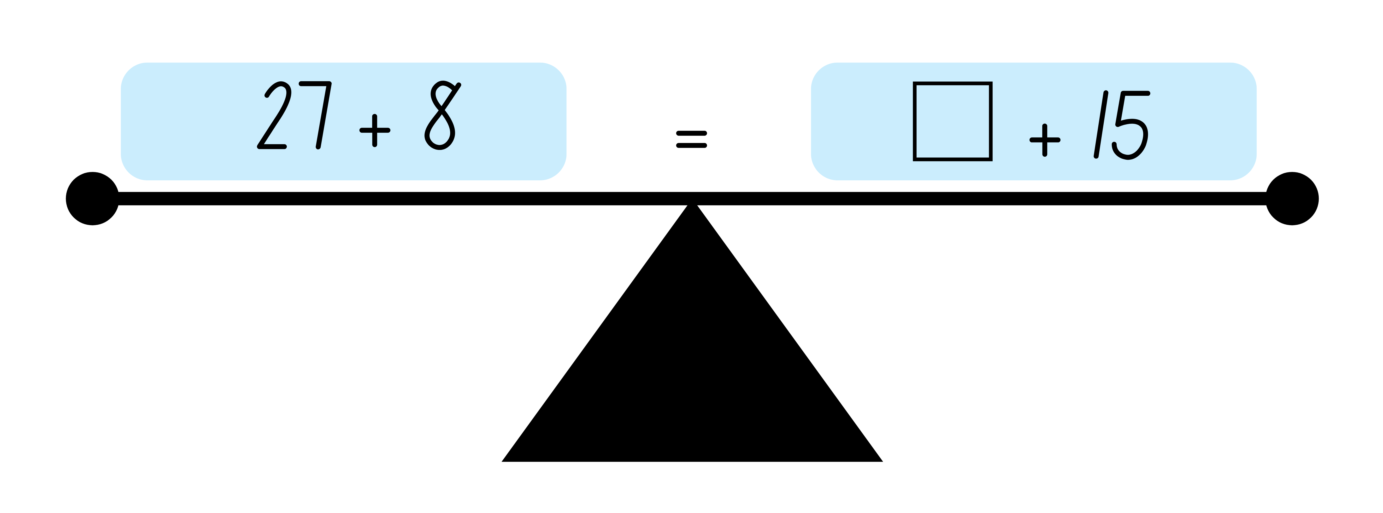
Short response (5)
Find the missing number:
Communicate your reasoning.
Notes:
Short response questions provide brisk paced questions focussing on review of current and previous content to support spaced and interleaved practice.
Syllabus focus area:
Additive relations B

Slide 14
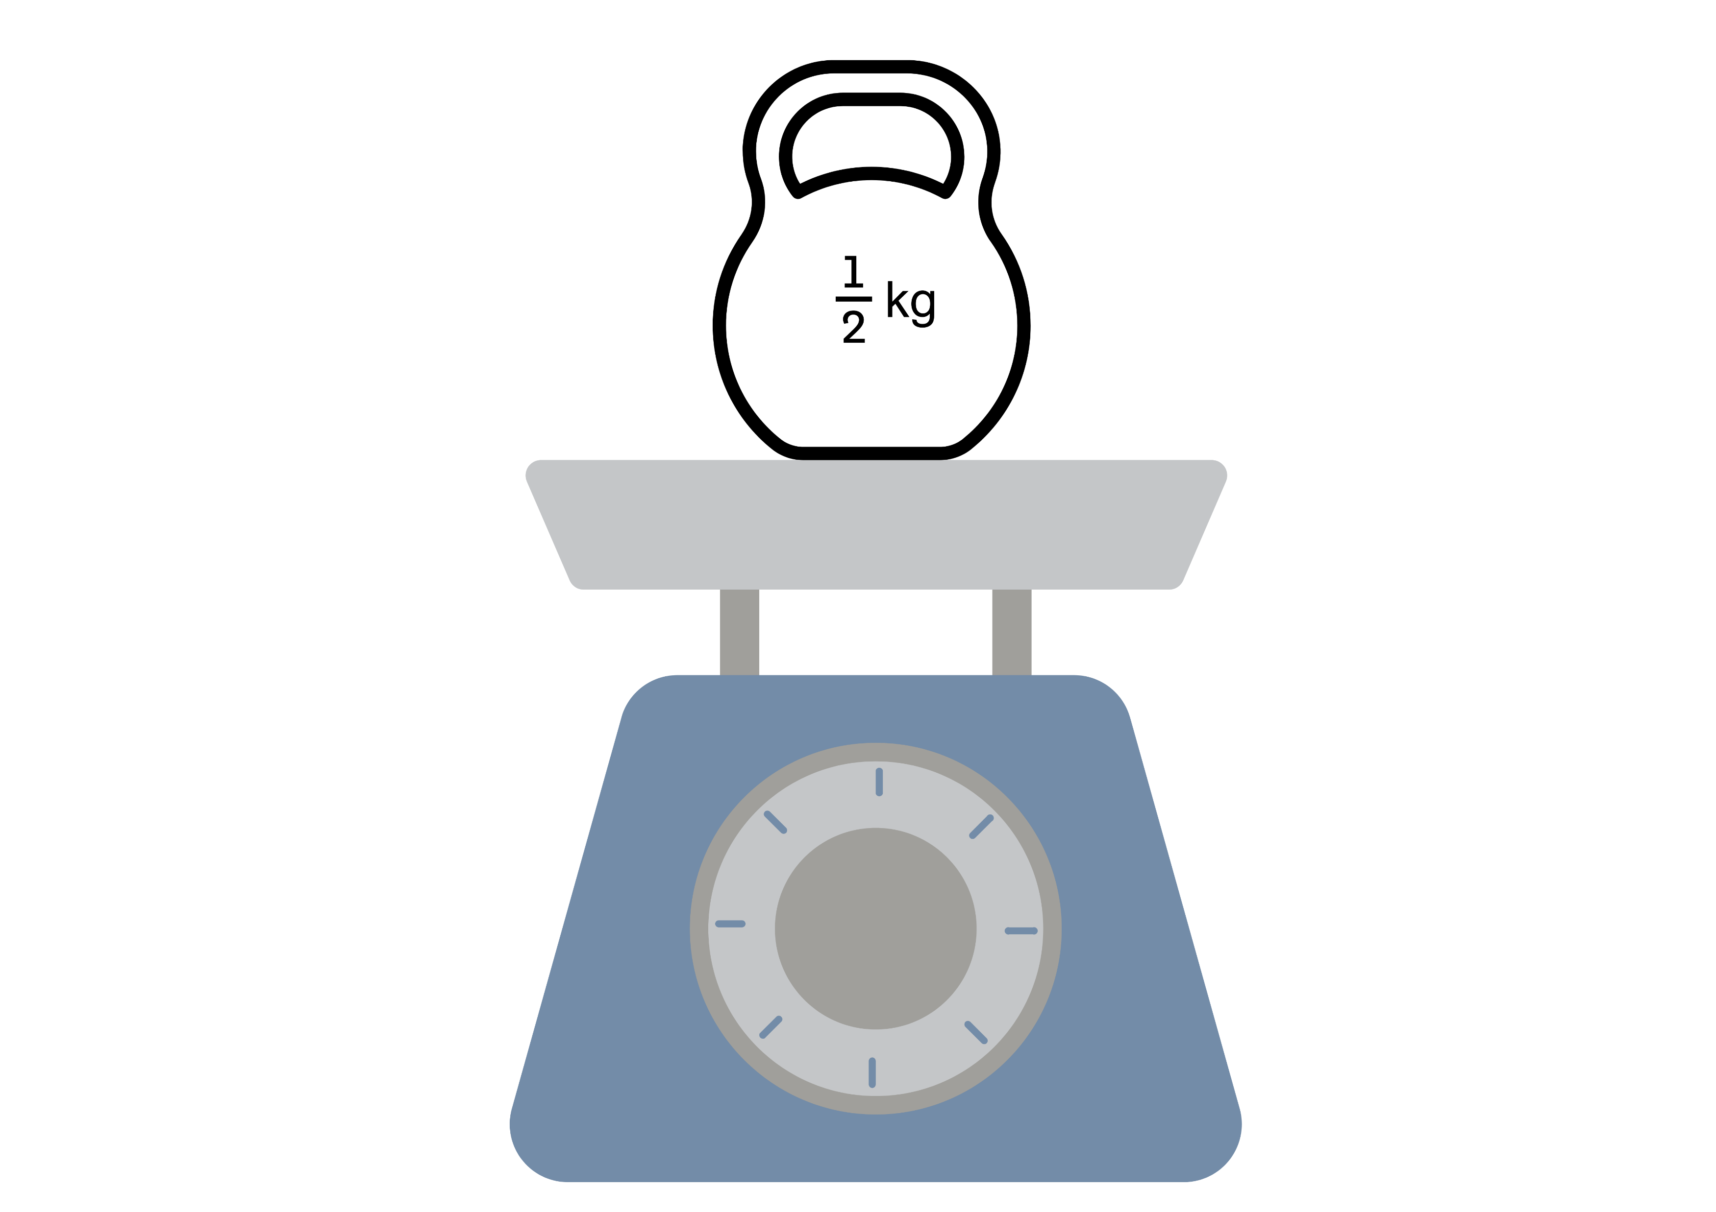
Short response (6)
Record the mass in grams.​
Communicate your reasoning.
Notes:
Short response questions provide brisk paced questions focussing on review of current and previous content to support spaced and interleaved practice.
Syllabus focus area:
Non-spatial measure B

Slide 15
Short response (7)
​
Use the distributive property to solve 7 × 8.​
Notes:
Short response questions provide brisk paced questions focussing on review of current and previous content to support spaced and interleaved practice.
Syllabus focus area:
Multiplicative relations B

Slide 16
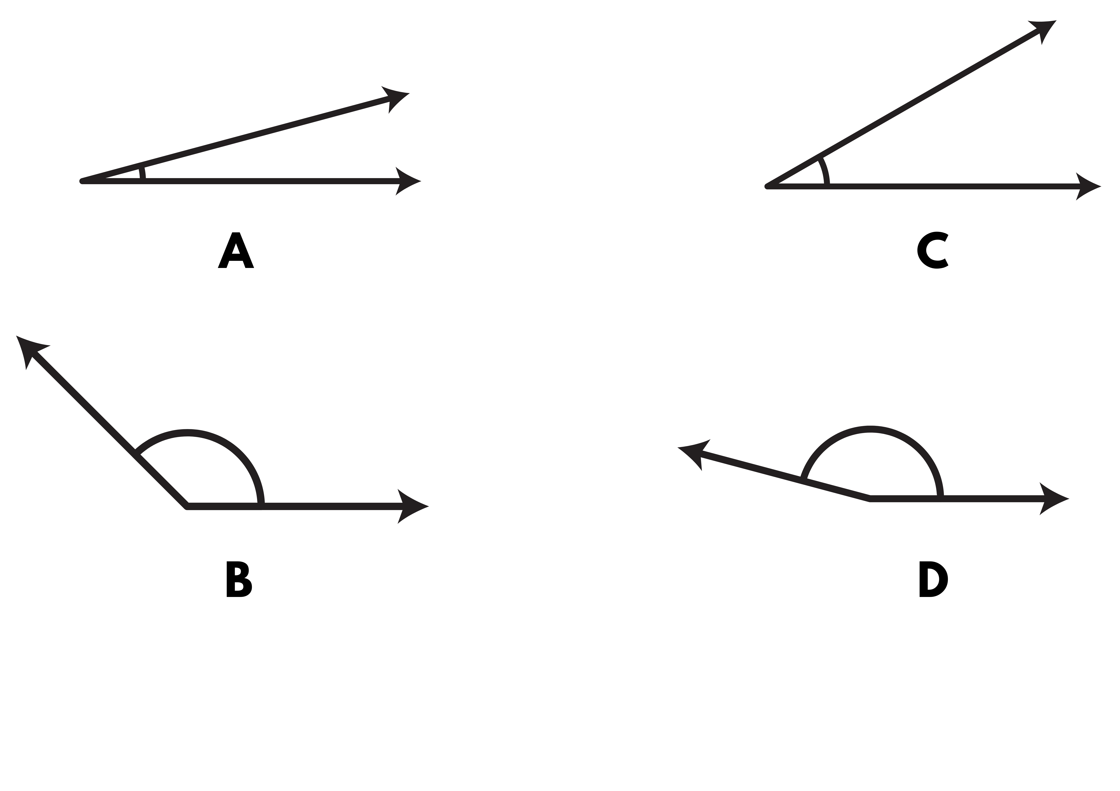
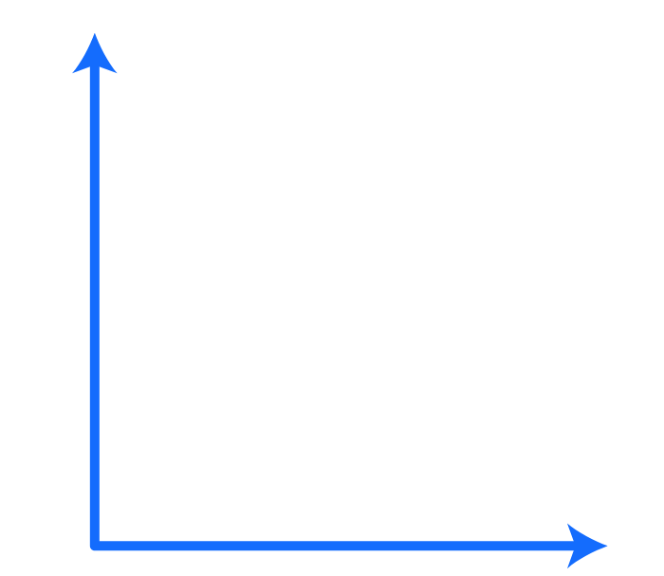
Short response (8)
Use the words less than, greater than, equal to or about the same to compare these angles to a right angle.
Notes:
Short response questions provide brisk paced questions focussing on review of current and previous content to support spaced and interleaved practice.
Syllabus focus area:
Geometric measure B

Slide 17
Activity 2 – finding unknown quantities in equivalent number sentences
__ + 7 = 23 + 12
23 – 8 = __ − 3
__ + 15 = 35 − 4
__ + 16 = 54 − 22
54 – 16 = __ + 29
__ + 20 = 75 − 27
103 + __ = __ − 18
__ – 24 = 155 − __
Notes:
This is a developing number sense activity.
Number sense refers to a deep understanding of numbers, including their magnitude, relationships, and the effects of operations on them. It supports fluency and understanding, estimation, flexible thinking, and efficient problem-solving. Number sense activities 1–4 ‘activate’ prior number knowledge and support the learning of new content in the unit. Number sense activities 5–8 ‘loop’ back and provide opportunity for spaced practice with concepts and procedures covered in previous units.
Syllabus focus area:
Additive relations B
Finding unknown quantities in equivalent number sentences
Ask students to record and solve the number sentences.
Select students to show and explain the strategies they used.
Ask students whether their strategies were efficient based on how many steps they used to solve the problem.

Slide 18
Review of learning 3

Slide 19
Multiple choice (2)
Which is the most efficient way to regroup when solving 527 + 83?
A
527 + 80 + 3
B
520 + 7 + 80 + 3
C
500 + 27 + 83
500 + 27 + 80 +3
D
Notes:
This question connects to the content in the developing number sense activity (Activity 3)
Syllabus focus area:
Additive relations B

Slide 20
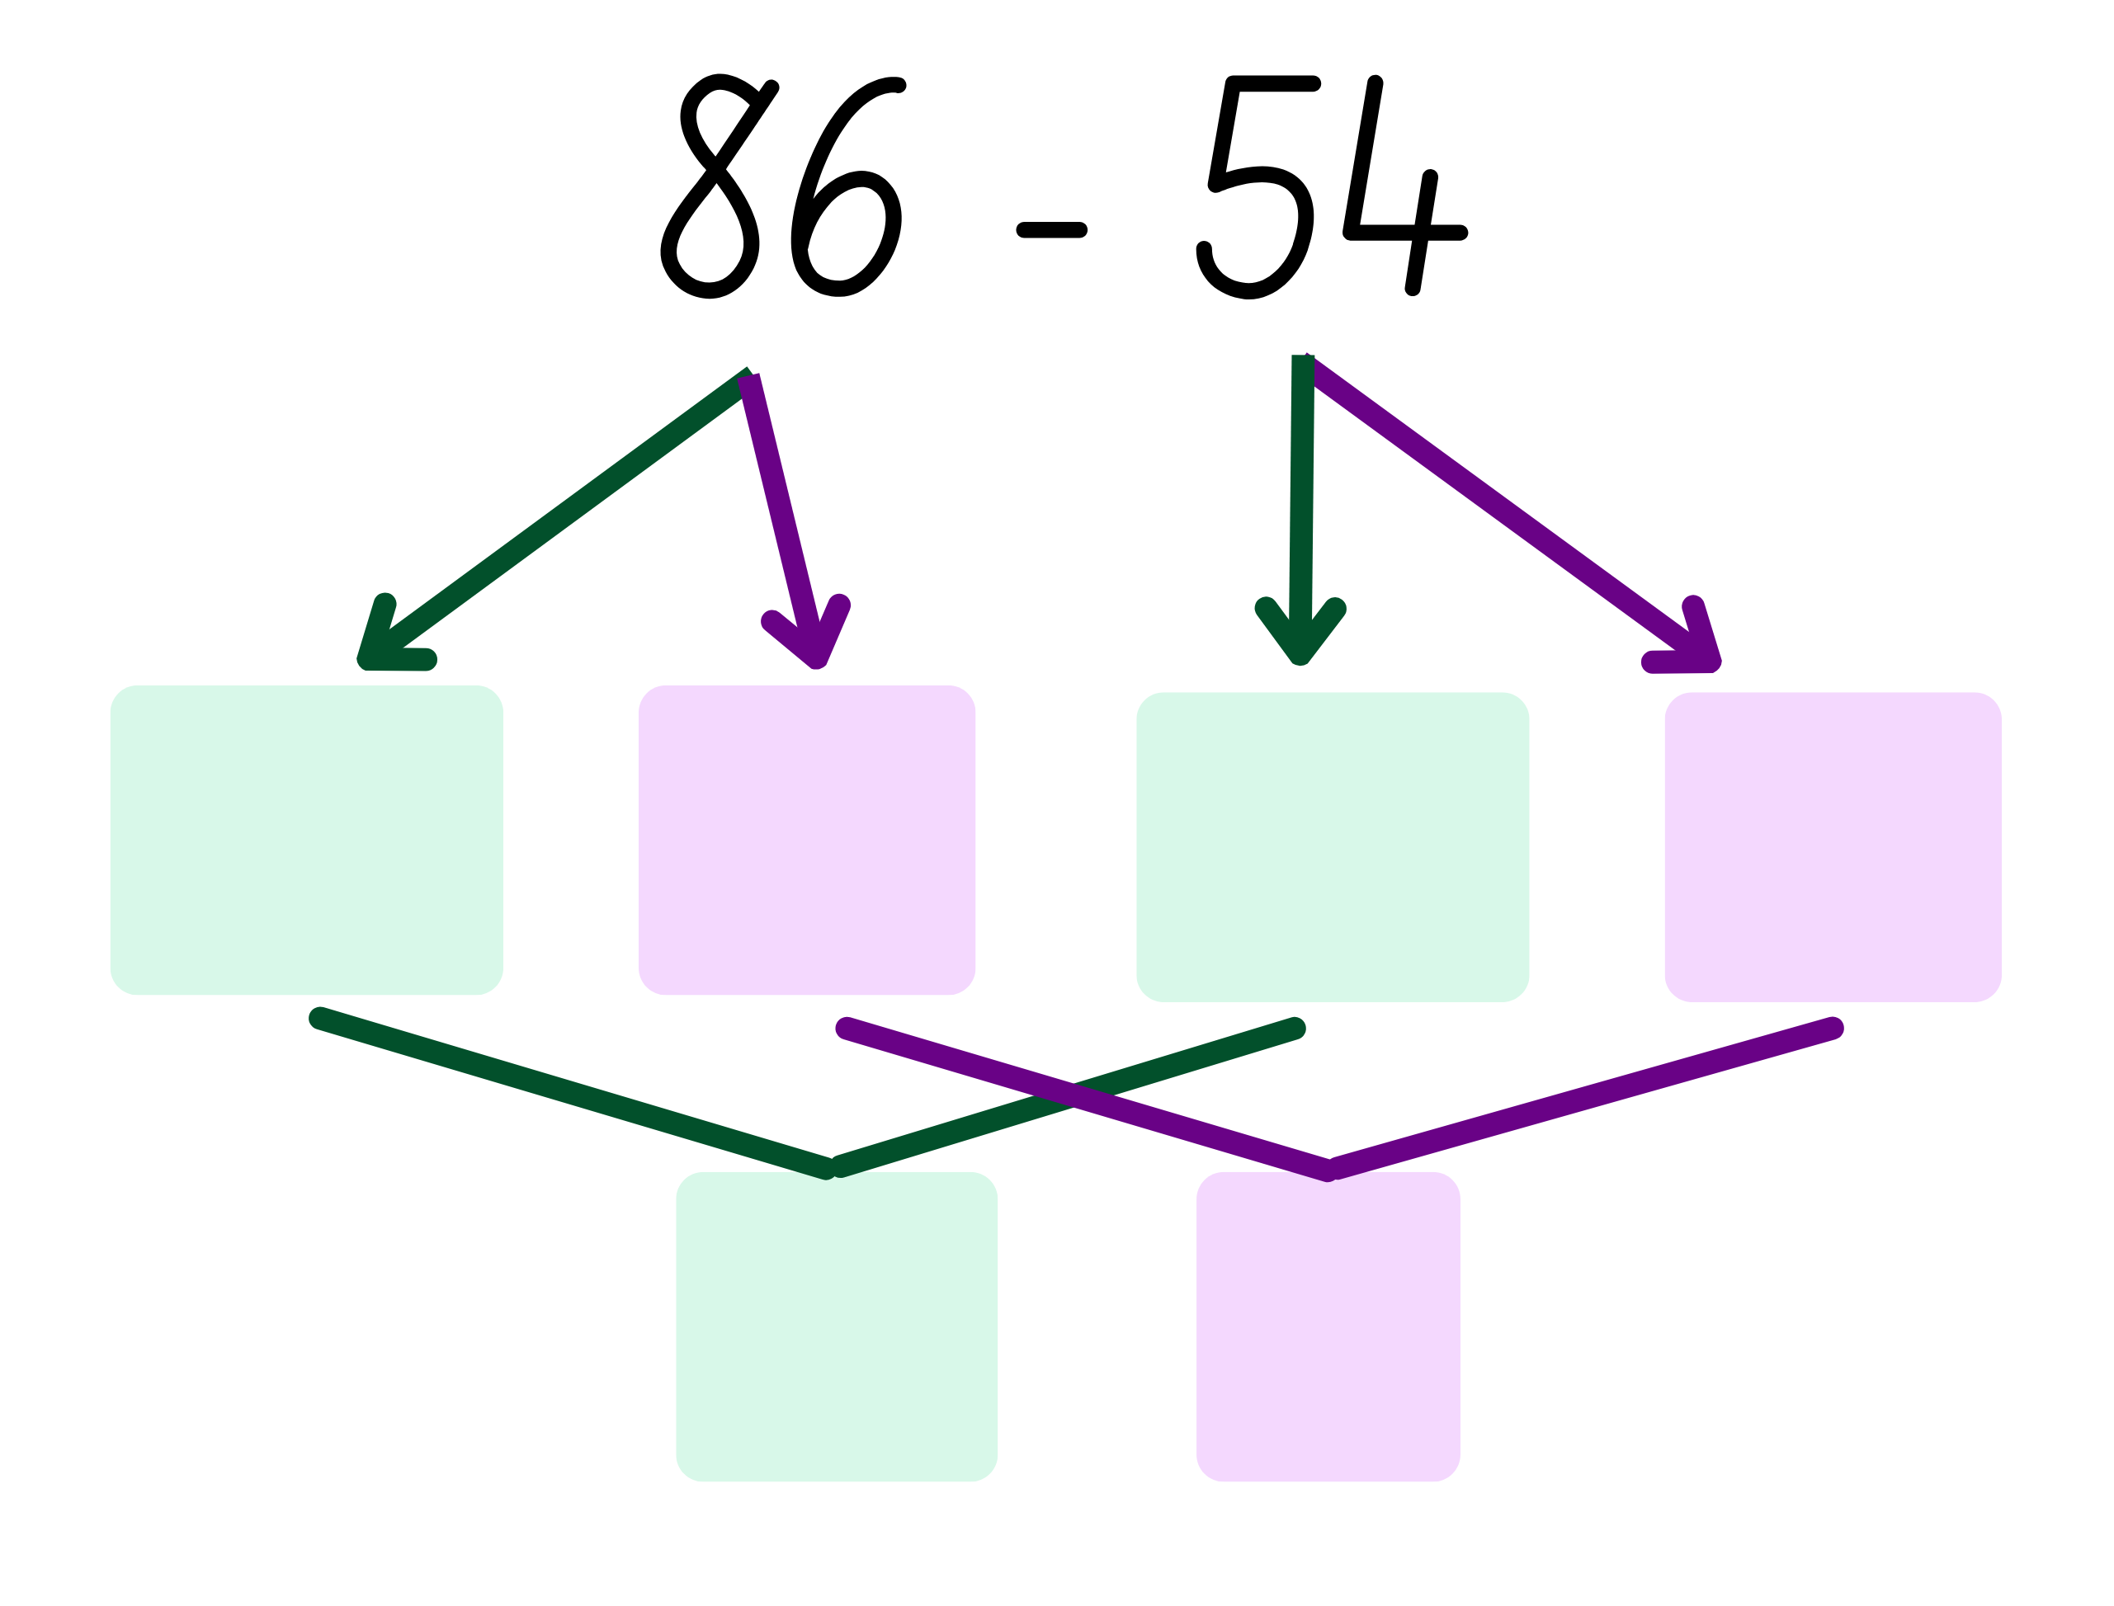
Short response (9)
Regroup each number using place value and complete the calculation.
Notes:
Short response questions provide brisk paced questions focussing on review of current and previous content to support spaced and interleaved practice.
Syllabus focus area:
Additive relations B

Slide 21
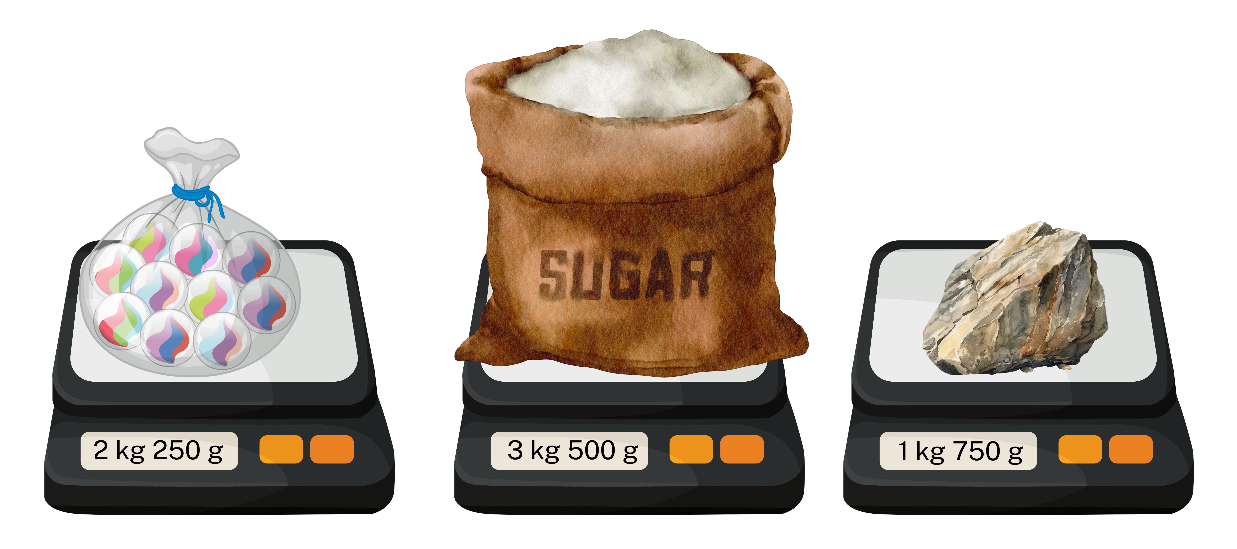
Short response (6)
Record the mass of the objects in grams.​
A
B
C
Notes:
Short response questions provide brisk paced questions focussing on review of current and previous content to support spaced and interleaved practice.
Syllabus focus area:
Non-spatial measure B

Slide 22

Short response (11)
This array is partially hidden.
How many counters are there in the
entire array?
Notes:
Short response questions provide brisk paced questions focussing on review of current and previous content to support spaced and interleaved practice.
Syllabus focus area:
Multiplicative relations B

Slide 23
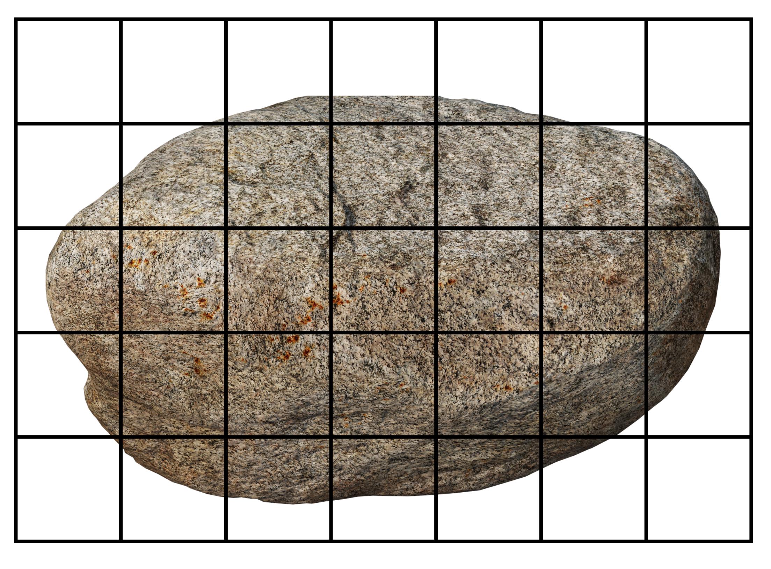
Short response (12)
Use the
square-centimetre
grid to estimate the area of this rock.
Notes:
Short response questions provide brisk paced questions focussing on review of current and previous content to support spaced and interleaved practice.
Syllabus focus area:
Two-dimensional spatial structure B

Slide 24
Activity 3 – solving addition problems using regrouping and place value
538 + 74
Notes:
This is a developing number sense activity.
Number sense refers to a deep understanding of numbers, including their magnitude, relationships, and the effects of operations on them. It supports fluency and understanding, estimation, flexible thinking, and efficient problem-solving. Number sense activities 1–4 ‘activate’ prior number knowledge and support the learning of new content in the unit. Number sense activities 5–8 ‘loop’ back and provide opportunity for spaced practice with concepts and procedures covered in previous units.
Syllabus focus area:
Additive relations B
Solving addition problems using regrouping and place value
On an individual whiteboard, students use regrouping to solve the addition problem.
Students repeat, this time by separating the numbers by place value: 538 = 500 (hundreds) + 30 (tens) + 8 (ones) + 74 = 70 (tens) + 4 (ones)
Students then selecting another flexible strategy by referring to the class anchor chart.

Slide 25
Review of learning 4

Slide 26
True or false (2)
65 – 43 can be regrouped as 6 tens and 5 ones minus 4 tens and 3 ones.
True | False
Notes:
The question on this slide connects to the content being explored in the developing number sense activity (Activity 4)
Syllabus focus area:
Additive relations B

Slide 27
Short response (13)
– 15 = 19
Jacob chose to use trial and error to solve the problem. Sophie wanted to use an inverse operation. Which strategy is more efficient?
Communicate your reasoning.
Notes:
Short response questions provide brisk paced questions focussing on review of current and previous content to support spaced and interleaved practice.
Syllabus focus area:
Additive relations B

Slide 28
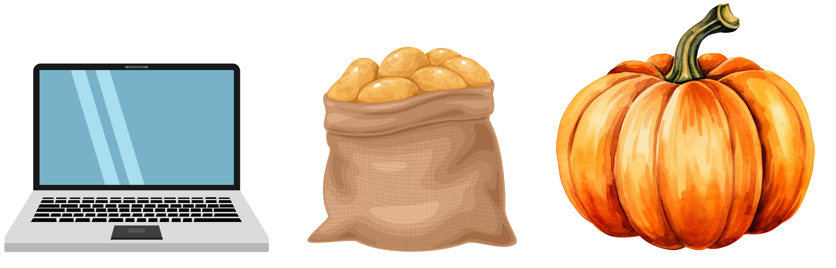
Short response (14)
Record the mass of the objects
in kilograms and grams.
1115 g 3250 g 4899 g
Notes:
Short response questions provide brisk paced questions focussing on review of current and previous content to support spaced and interleaved practice.
Syllabus focus area:
Non spatial measure B

Slide 29
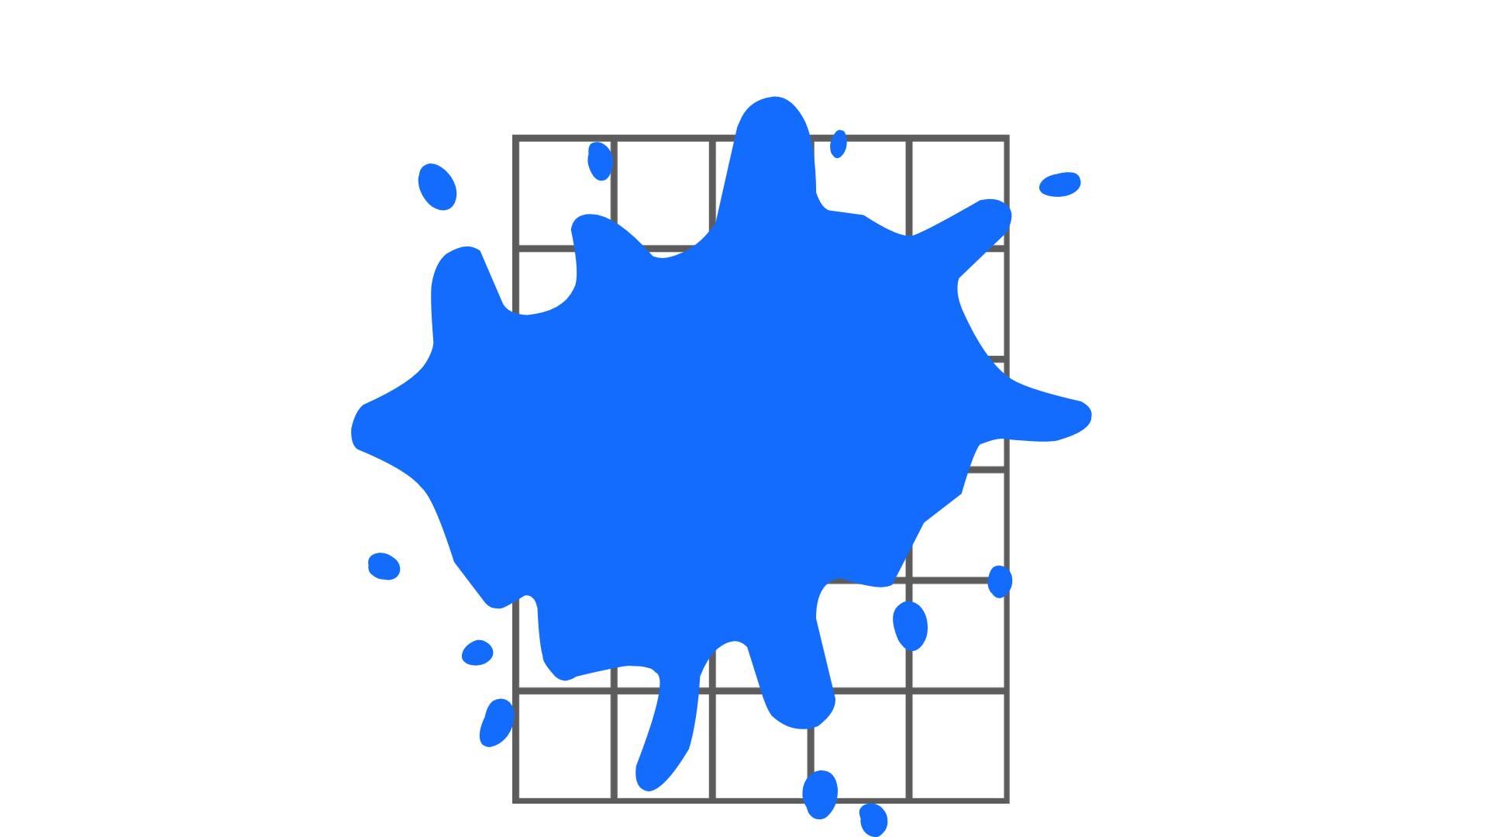
Short response (15)
This area model is covered with paint.
Record the multiplication
sentence to show the total number of squares
in the entire grid.
Notes:
Short response questions provide brisk paced questions focussing on review of current and previous content to support spaced and interleaved practice.
Syllabus focus area:
Multiplicative relations B

Slide 30
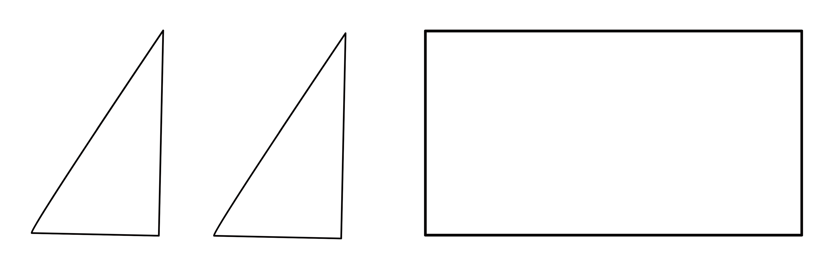
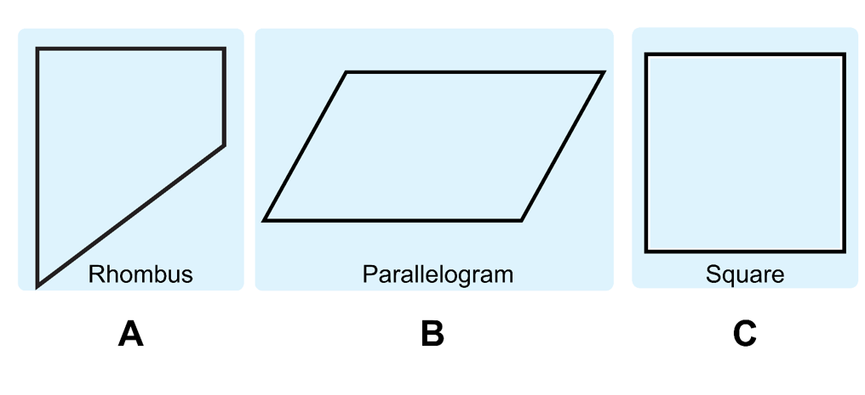
Short response (16)
If you combine the 3 shapes above, which shape can they form?
Notes:
Short response questions provide brisk paced questions focussing on review of current and previous content to support spaced and interleaved practice.
Syllabus focus area:
Two-dimensional spatial structure B

Slide 31
Activity 4 – solving subtraction problems using regrouping and place value
538 − 74
Notes:
This is a developing number sense activity.
Number sense refers to a deep understanding of numbers, including their magnitude, relationships, and the effects of operations on them. It supports fluency and understanding, estimation, flexible thinking, and efficient problem-solving. Number sense activities 1–4 ‘activate’ prior number knowledge and support the learning of new content in the unit. Number sense activities 5–8 ‘loop’ back and provide opportunity for spaced practice with concepts and procedures covered in previous units.
Syllabus focus area:
Additive relations B
Solving subtraction problems using regrouping and place value
On an individual whiteboard, students use regrouping to solve the subtraction problem.
Students repeat, this time solve by separating by place value: 538 = 500 (hundreds) + 30 (tens) + 8 (ones) minus 74 = 70 (tens) + 4 (ones)
Students then select another flexible strategy by referring to the class anchor chart.

